Slide 1
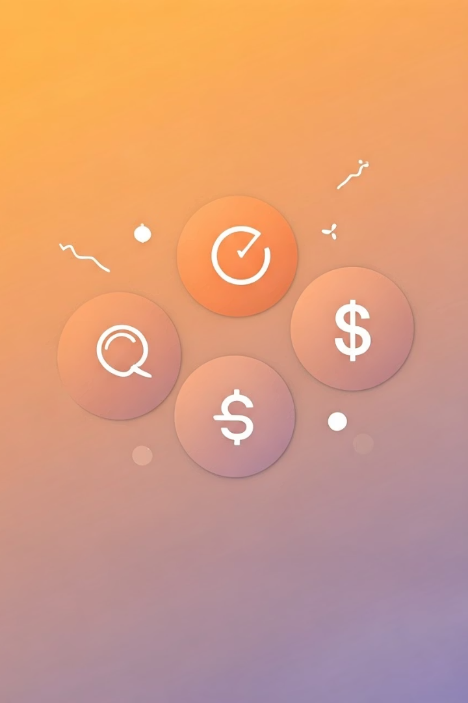
What is RFM Analysis?
RFM (Recency, Frequency, Monetary) segments customers based on purchase timing, frequency, and spend. Identifies valuable, loyal, and at-risk customers for targeted marketing.

Slide 2
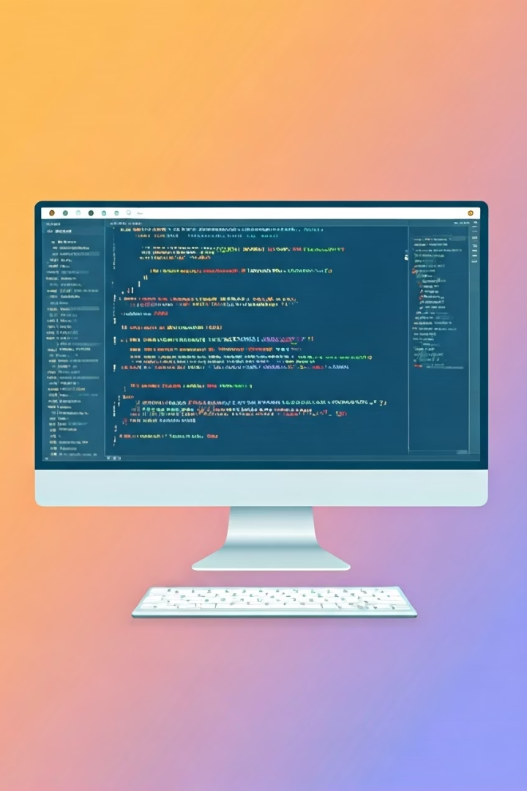
Simulating Transaction Data
Dataset Size
Time Range
1,000 Customers, 5,000 Transactions
Jan 2023 to June 2024
Key Columns
CustomerID
TransactionDate
TransactionAmount

Slide 3

Creating RFM Table
Group by CustomerID
Aggregate transactions per customer
Recency
Days since last purchase
Frequency
Total number of transactions
Monetary
Total spend per customer

Slide 4
RFM Scoring System
Score Assignment
Score Range
Combined Score
Quantile binning divides customers into 5 groups
1 = Lowest, 5 = Highest value customers
Three-digit RFM code ranks customers

Slide 5

Segmenting Customers by RFM Score
Champion Segment
Loyal Customers
High scores in all three metrics
Frequent buyers, moderately recent
At Risk
Hibernating
High spend but long time since last purchase
Inactive, low frequency and spend

Slide 6
Data Visualization
Customer Distribution
Revenue Concentration
Score Patterns
Large low-frequency segment in data
Small segment contributes most revenue
Distinct trends in R, F, M score breakdowns

Slide 7

Key Business Insights
Top 10% Drive Revenue
Contribute over half total revenue
Re-Engagement Needed
Large group inactive, needs attention
Retain Champions
Use targeted loyalty programs
Focus on At Risk
Prevent churn with special offers

Slide 8
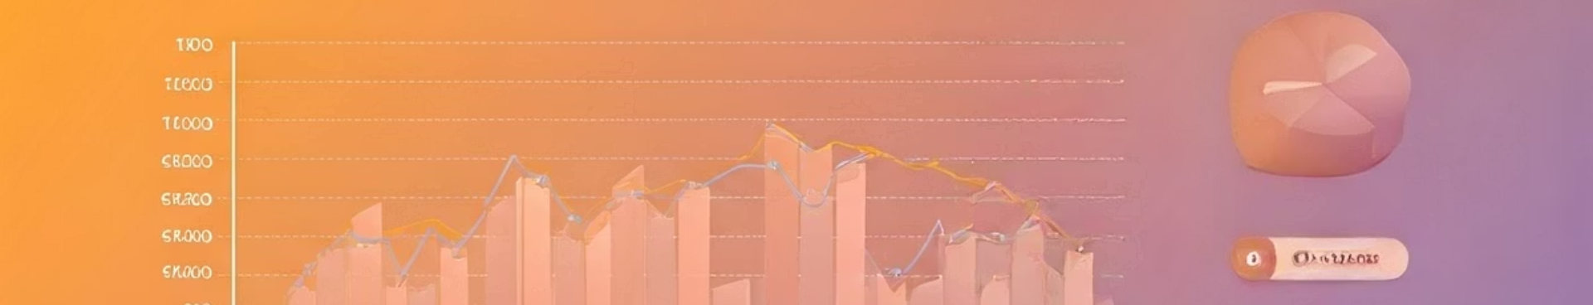




Real-World Use Cases & Next Steps
Targeted Campaigns
Retention & Loyalty
Machine Learning
Automation
Improve customer lifetime value
Integrate RFM segments as features
Monthly RFM updates & CRM integration
Personalized messaging by segment

